Slide 1
jumpman23

Slide 2
Data Integrity
For this analysis, most known data integrity issues were fixed.
Issues encountered and fixed:
Total Pickup Time longer than Total Delivery Time was deleted
MPH traveled by bike >100 MPH and similar outliers was deleted
Total delivery time > 4 hours and similar outliers was deleted
Closed, archived, and deprecated locations was deleted
Non-standardized merchant names were standardized (879 distinct merchants from 896)
Duplicate delivery Ids were aggregated and then removed (5102 deliveries from 5840)

Slide 3
Popular vehicles and wait times
Vehicle | Wait Time
Bike | 13 Mins
Car | 17 Mins
Motorcycle | 12.7 Mins
Scooter | 12.8 Mins
Truck | 24 Mins
Van | 17 Mins
Walker | 14 Mins
We see higher wait times for cars, trucks, and vans due to need to find parking
We see high amount of bikes used in city, consider further promoting bikes, walkers, motorcycles for higher city efficiency.

Slide 4
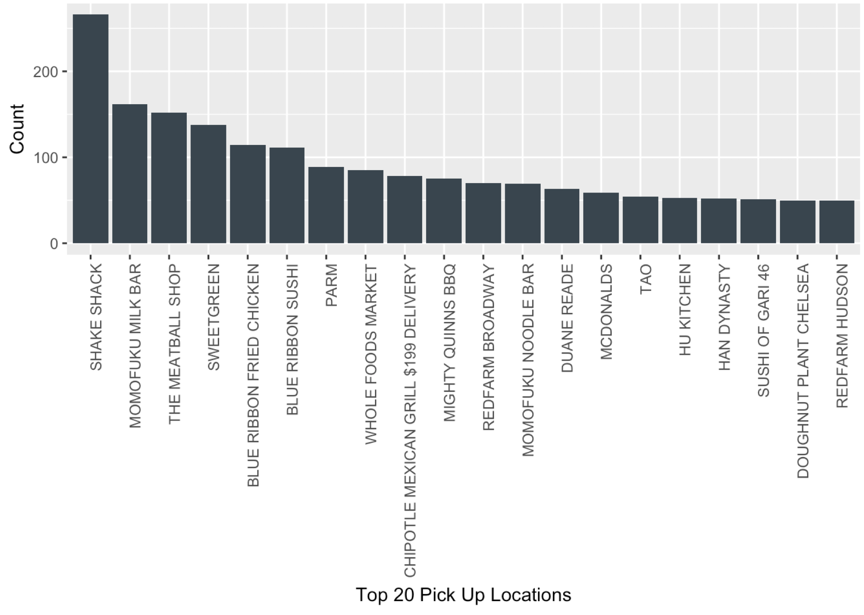
Most popular Merchants
Consider featuring popular merchants and place categories on front page of app

Slide 5
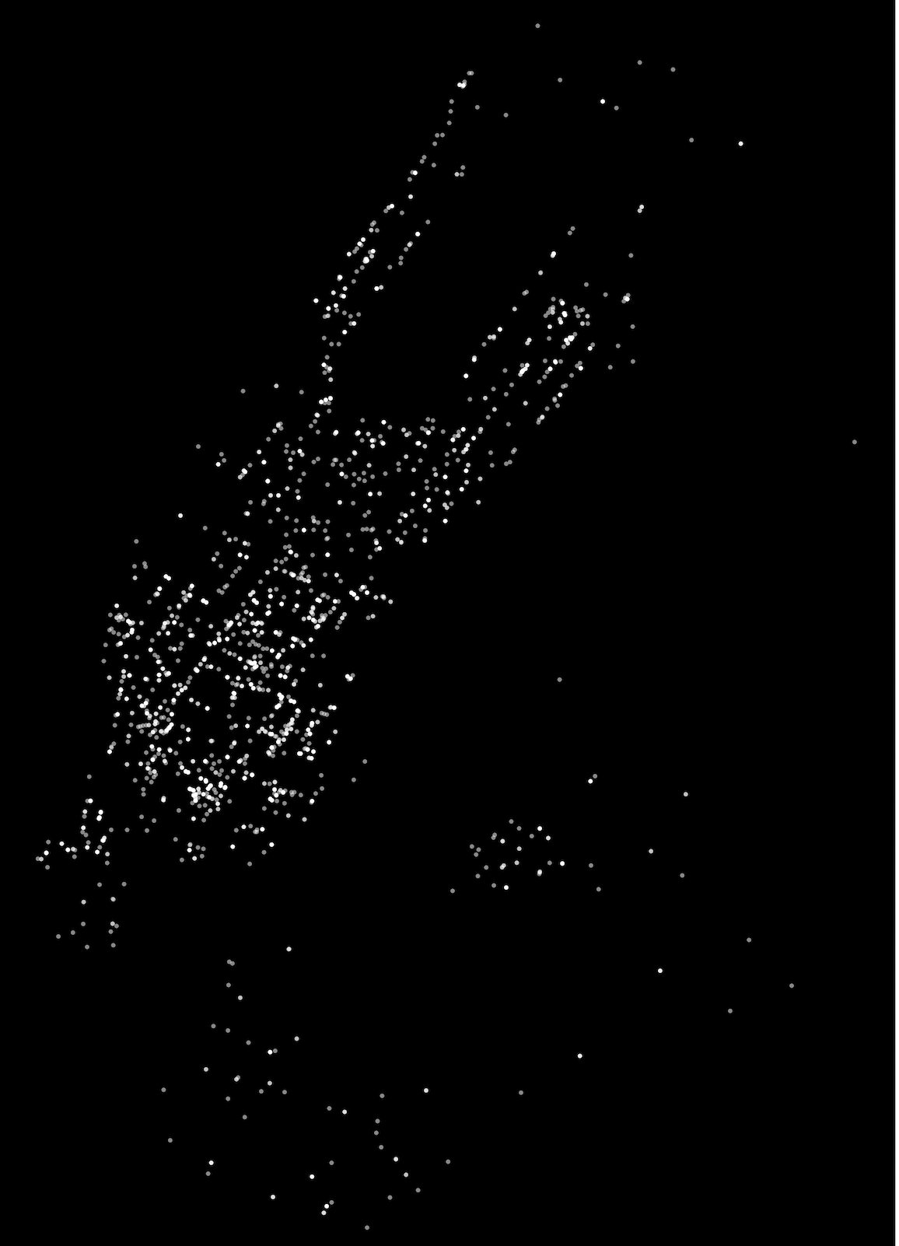
popular pick up areas
Concentrated clusters around the city exist
Consider adding a feature in app to direct Jumpmen to current hotspots to reduce time needed to travel from original starting position and pick up

Slide 6
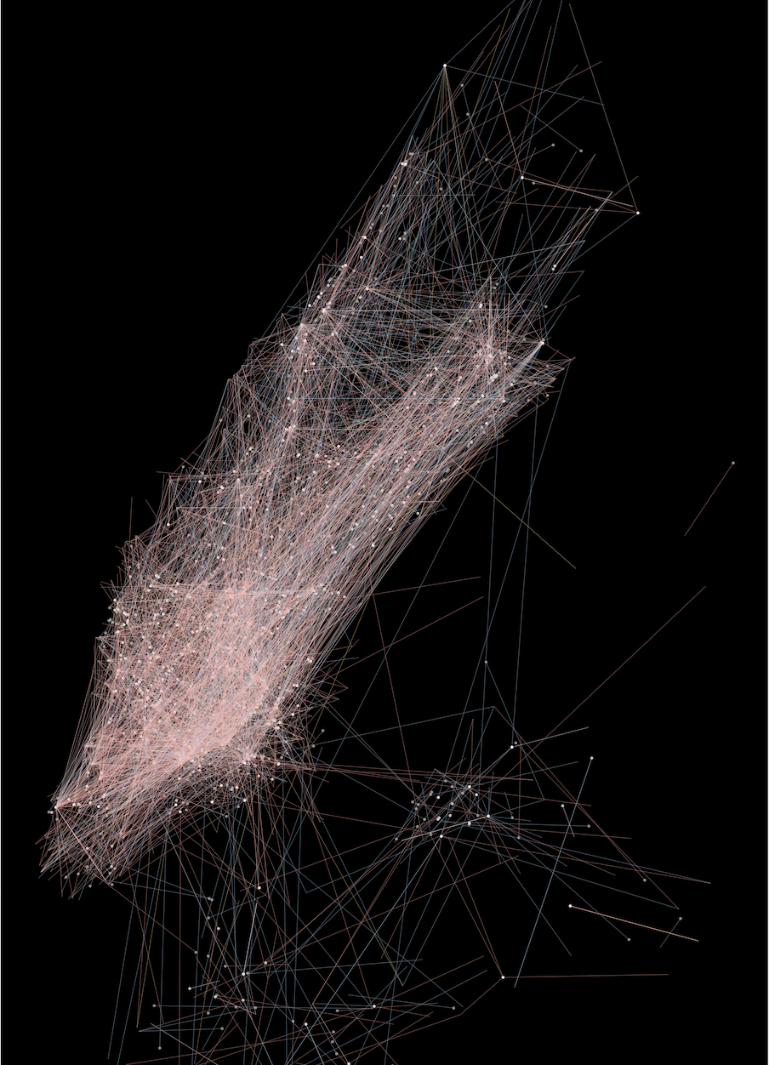
Routes traveled
Most popular routes by vehicle type.
Bikes (red) are most popular
Cars (blue) are second popular
Cars travel across Central Park

Slide 7
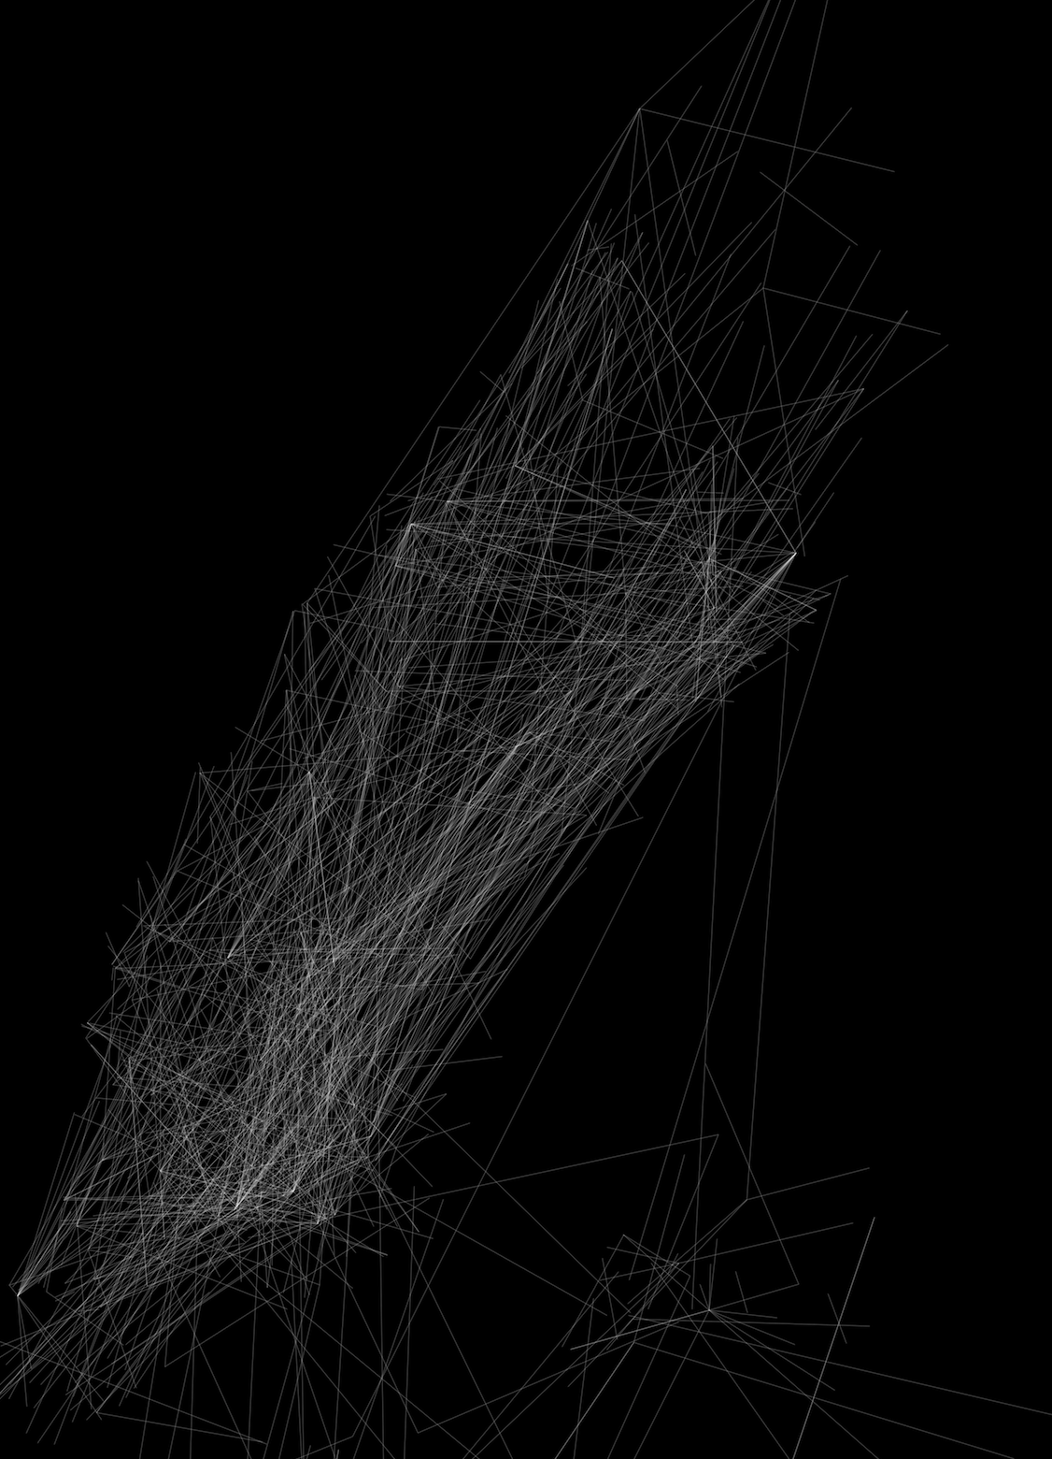
Increase efficiency
Plot depicts straight line traveled for all cars
Might be more efficient to send bikes/walkers across park than cars (they have to drive around)
Consider adding this as feature in app

Slide 8

Walkers sent far distance
Some walkers are sent far distances across New York for deliveries
Consider limiting the max distance walked for efficiency

Slide 9
High demand hours
Noon and dinner time are the most popular times of the day
Possible pricing strategy by demand
Can recommend to encourage more carriers be available at this time

Slide 10
Demand heat map - week
Saturday, Thursday, and Wednesday night have the heaviest demand.
Consider allocating more carriers during that time

Slide 11
Thank you

